Slide 1

Business Analyst Career Program - Capstone Project
- By SHUBHAM BHARTI
1

Slide 2

Agenda
Data Exploration
Statistical Analysis using Excel
Graphical Analysis using Excel
Insert the given data into the SQL server
Import the Data from the SQL Database into PowerBI
Interactive Dashboard by using visualization tools
Conclusion and Inferences
Endnotes

Slide 3
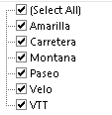
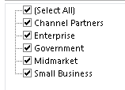
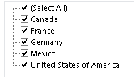
Data Exploration
There are 16 count of rows and 701 count of column.
In discount band there are 53 cells that have no discount.
Highest sales occurred on 7th july 2014 by Paseo.
Minimum sales by Canada on 1st jan 2014 segment govt.

Slide 4
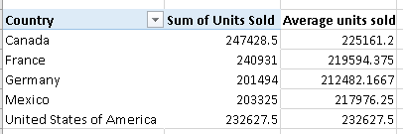
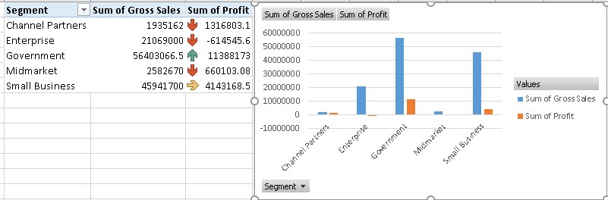
Statistical Analysis using Excel

Slide 5
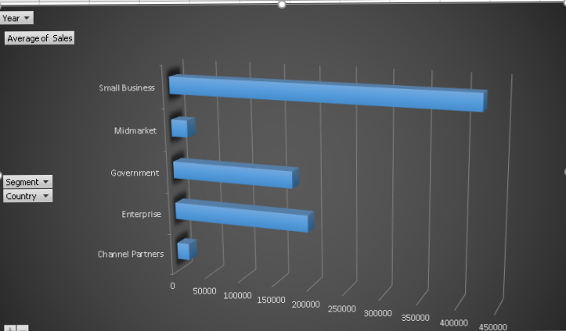
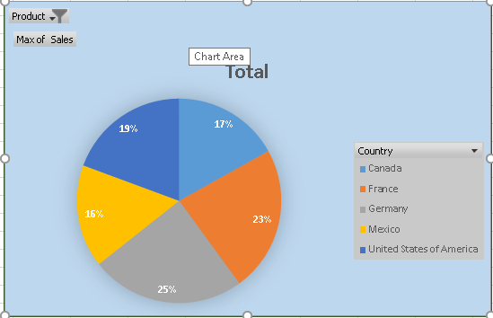
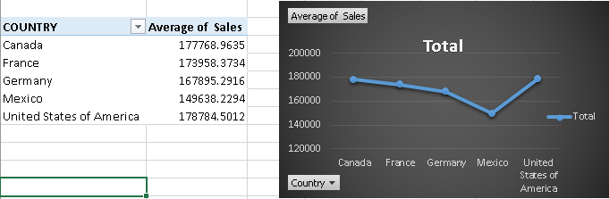
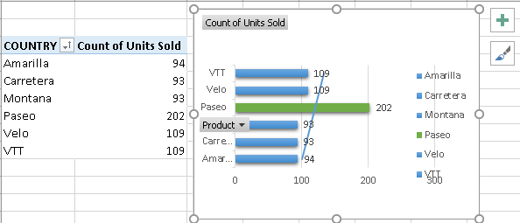
Graphical Analysis using Excel
product

Slide 6
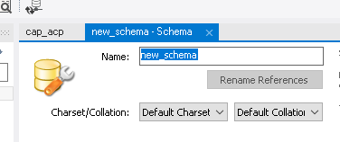
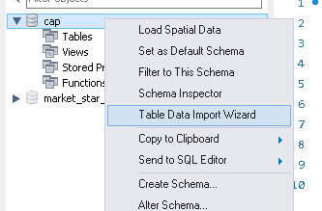
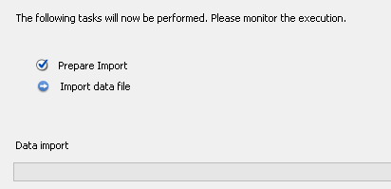
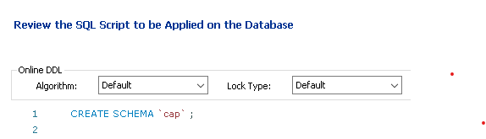
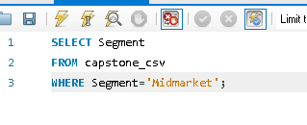
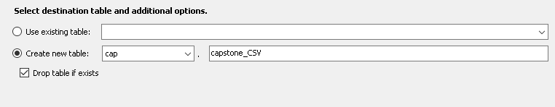
Insert the given data into the SQL server

Slide 7
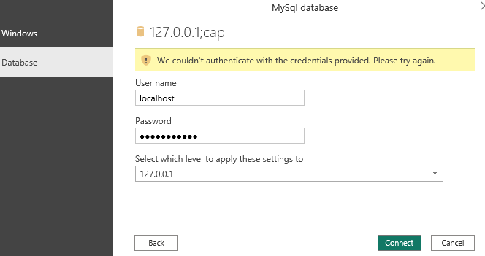

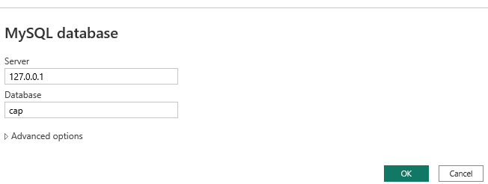
Import the Data from the SQL Database into PowerBI
First we click on get data
Select my MySQL database
Then enter server name and database name
Then select database end enter username and password then press ok

Slide 8
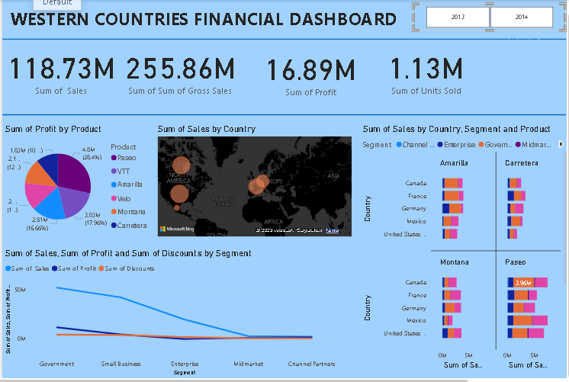
Interactive Dashboard by using visualization tools

Slide 9
Conclusion and Inferences
After doing graphical analysis we have seen that the small enterprises have made a good average of sales
And pie char shows that the max of sales are better in Germany.
And on the next chart you can see that the paseo has the max of product count sales as compared to others .
After doing statistical analysis we have made one more column named average of sales in which we have calculated the average of sum of units sold.

Slide 10
Endnotes
Reference Links:-
https://1drv.ms/x/s!ArreysmR9pEqmgQRdTsHpBV_qY22

